Slide 1
Incremental Unit Testing
Ye, Jiabin
Shanghai Jiao Tong University
2015/5/31

Slide 2
Changes
Optimize the Test Runner with >10x speed up
Keep all log in one file to minimize I/O operations
Fix minor bugs

Slide 3
Prerequisite
setting IUT_HOME folder -> $HOME/.iut
TestRunner : java binary for running Junit test
iut.jar: java binary supporting commands in last page
iut.sql: database definition script
plugin-runtime: gradle plugin files
projects: project databases

Slide 4
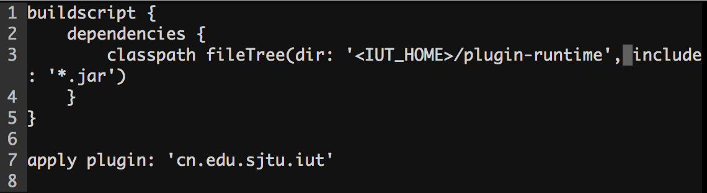
Prerequisite
Add following lines in `build.gradle`

Slide 5


Workflow Review
Sample project : https://github.com/jayway/JsonPath
project root
<subproject>
json-path
src
json-path-assert
build.gradlle
json-path-web-assert

Slide 6
Sample Configuration
{
"type": “gradle", // optional, gradle project is the only project type supported
"srcdirs" : [“./json-path/src/main/java"], // required when invoking `inst` or `diff`
"database": {
"type": “sqlite", //
"host" : “<some-dir>/iut.db”, // required absolute path
"db" : “iut", // optional
"username" : “iut", // optional
"password" : “iut" // optional
}
}
iut.json

Slide 7
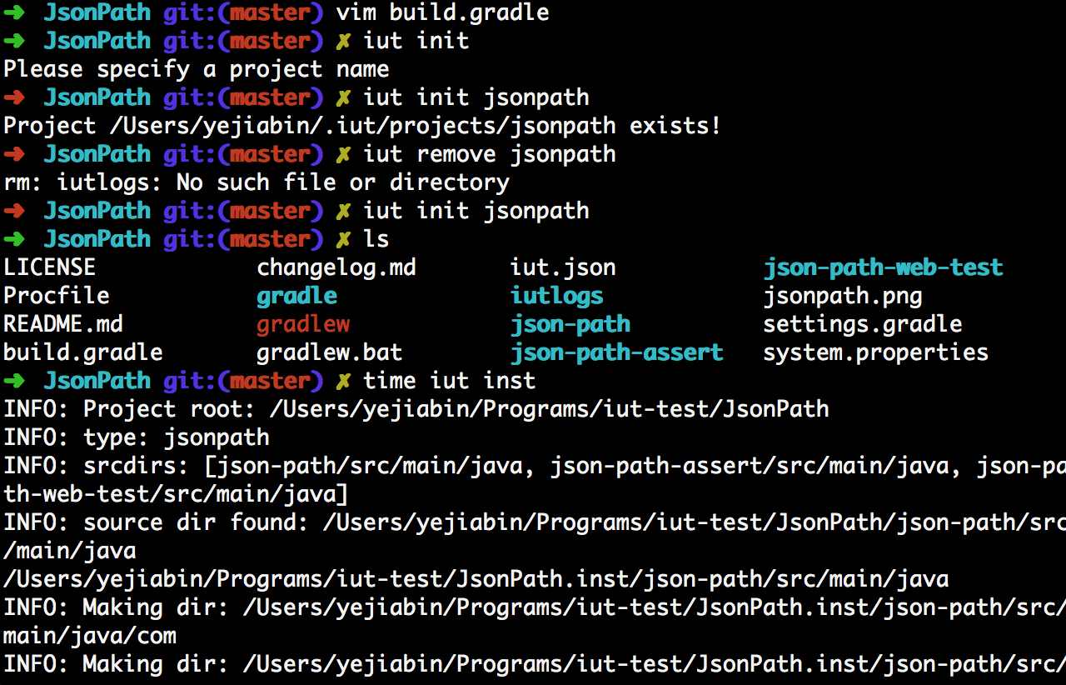
Workflow Review
Initialize
run gradle plugin task to find all source folder
create iut.json @ project root
create database file @ iuthome
create iutlogs folder for execution path logs

Slide 8
Workflow Review
instrumenting the project
$ iut inst
read & parse configuration
copy the whole project
instrumenting all source files

Slide 9

Workflow Review
instrumenting the project
$ iut inst
read & parse configuration
copy the whole project
instrumenting all source files
project root
json-path
src
json-path-assert
build.gradlle
list of source directory
json-path-web-assert
iut.json

Slide 10
Instrumenting Strategy
See IutLogger.java
Instrumenting call statement of the logger in each method body
Maintain a set of invoked method to ensure each method will be logged at most once
why source code ? @see discussion in mail 2015/1/20

Slide 11
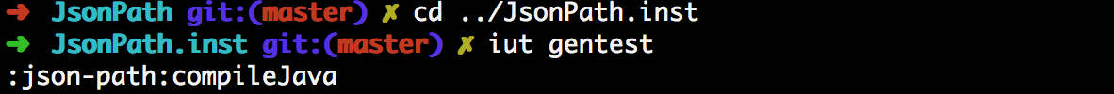
Workflow Review
generate all available Test
$ iut gentest
run gradle testClasses task
run gradle plugin task to find all available test cases
and save the result to file `iut-test`

Slide 12
Workflow Review
generate all available Test
iut-test file format
:classpath:classpath1:…
com.some.company.tool#testA
com.some.company.tool#testB
com.some.company.tool#testC
com.some.company.tool#testD
:classpath:classpath2:…
com.some.company.tool#testE
test methods followed by its runtime class path

Slide 13
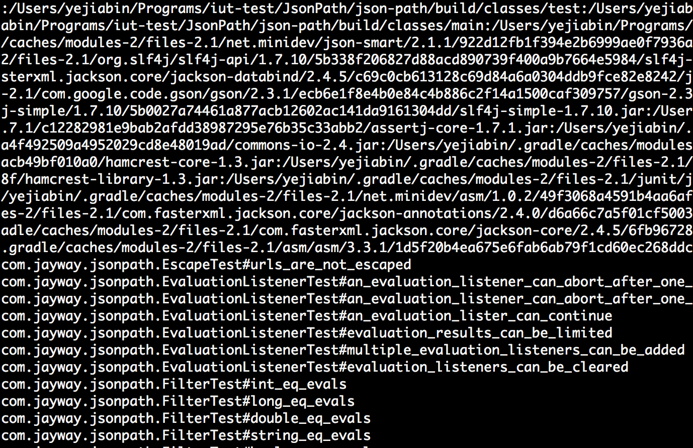
Workflow Review
sample file of ‘iut-test’’

Slide 14
Workflow Review
Run the tests
$ iut testall
Restriction compared to `gradle test`:
using a wrapped JUnit runner (@ $IUT_HOME/TestRunner) to run all test cases and only projects using 4.x JUnit are currently supported
Slower than `gradle test`, for `iut testall` run method level test case individually and sequentially. An environment variable is keeping updated each time a test case is going to run.
Dose not apply include/exclude/scanTestCases and other gradle specified testing rules

Slide 15
Implemetation & Difficulties in
Gradle based-project
To get all test case ids
using test API (currently using) (http://gradle.org/docs/current/dsl/org.gradle.api.tasks.testing.Test.html)
logger all descriptor when beforeTest Event is triggered
Pros: easy to implement
Cons: require a more test task to log it (it can be done in dev time)
Alternatively way, parse all test case Java files
Pros: cost less time
Cons: parse gradle settings to find all candidate files, need to support test frameworks that gradle supported
implemented

Slide 16

Implemetation & Difficulties in
Gradle based-project
Executing test cases
Using test API :afterTest/beforeTest is not suitable
Manually control the test sequence in ./test.sh
test script process (gradle)
beforeTest
afterTest
IPC
test program process
setup
execution

Slide 17
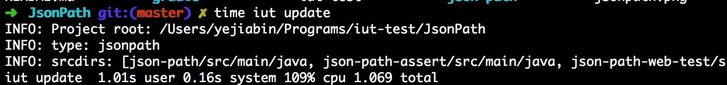
Workflow Review
update the data base
$ iut update
read & parse configuration
connect to the database
read all test case log files
update database

Slide 18
Workflow Review
diff & show the result
$ iut diff <src> <dst> # MUST BE Absolute project path currently
read & parse configuration
perform method level diff
query database for affected test cases
save the result to file `affected-test-case`

Slide 19
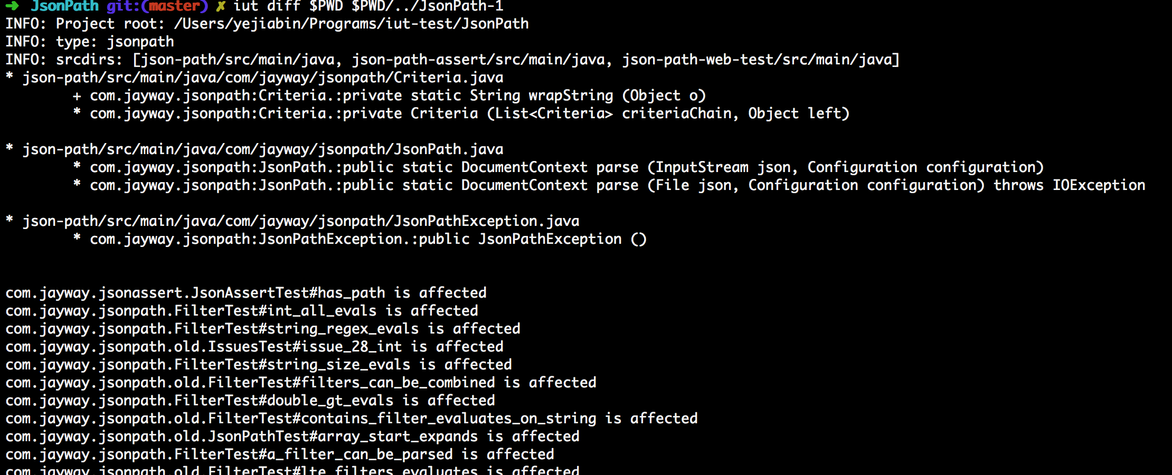
Workflow Review
diff & show the result

Slide 20
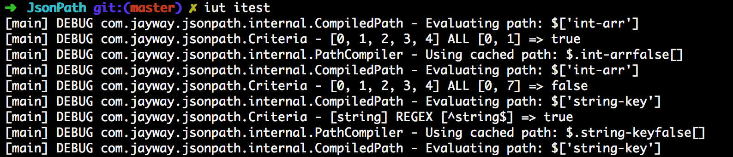
Workflow Review
increment testing
$ iut itest
convert `affected-test-case` to the format of `iut-test`
simply execute the test runner as in `iut testall`

Slide 21
Workflow Review
origin
DB
init
diff
origin
inst
origin
./project.inst
affected-test-case
both
gentest
iut-test
both
itest
both
testall
inst
iutlogs
update
if in inst
if in inst

Slide 22
Workflow Review
create
read
update
must run the command in
the origin project folder
origin
must run the command in
the instrumented project folder
inst
both
either instrumented or origin

Slide 23
Benchmark
 | Spring | JsonPath | gson-xml
cloc | 508,167 | 8,170 | 1,737
#testcase | 10056* | 291 | 32**
inst time (s) | 19.823 | 1.687 | 0.981
gradle test (s) | 7’47.38 | 16.264 | 5.972
testall (s) | 8’29.96 | 1.497 | 0.546
testall.inst (s) | 21’18.37 | 1.921 | 0.680
update (s) | 4:16’6.05 | 45.615 | 5.568
diff (s) | 37.941 | 3.448 | 2.612
diff between origin & instrumented code
* because of the gradle configuration, 11453 test case detect, 10056 test would run
** 33 test cases in origin project but one test case failed

Slide 24
Case Analysis - Spring
We simply modify a constructor in ./spring-aop/src/main/java/org/springframework/aop/aspectj/autoproxy/AspectJPrecedenceComparator.java
it takes 2.972 s to perform `iut diff`
19 test cases are affected
incrementally testing 19 test cases cost 3.112 s

Slide 25
Case Analysis - Spring
original version
new version
inst
testall
update
diff
itest
19.8 s
21 min 18 s
+ 540 M logfile
4 hr 16 min
+ 743 M db file
2.972 s
3.112 s
Ideally, it will save > 7 minute
for a developer to test in this case.
However, the overhead of
preprocessing original version
is very large.
gradle test
7 min 47 s
comparison between traditional & IUT workflow

Slide 26
Implementation Status
Basic incremental unit testing tool
instrumentation source code for logging
find method level difference between two source folder
maintain a database to keep track the relationship between test case and method
a simple bash script to support workflow @page21, and each single step in this workflow is implemented

Slide 27
Limitations
Only Gradle project with JUnit 4.x is supported
Some Gradle test options are not supported (e.g. include/exclude rules, system environment, etc)

Slide 28
Possible Improvements
If a version control system is used (e.g. svn), IUT can simply parse the diff file generated by the version control system.
The test runner should have as many testing options as Gradle does. But if IUT can work on other build system (e.g. ANT), testing options in ANT should also be supported.
To support varies kinds of build system or database or even programming languages based on the same workflow.

Slide 29
Other thoughts
The vital points of this topic are diff & collection relationship between test cases and methods.
diff - It’s hard to evaluate which of the level (basic block, method, class, etc) is the best because we have the considerations in the table below.
diff level | fine-grained | coarse-grained
affected tests | less | more
time for analysis | more | less
implementation | more difficult | easier

Slide 30
Other thoughts
static vs dynamic
As the benchmark result shows, the dynamic approach has a large overhead both in time and space. If we use static analysis, the cost of time and space must be far less than dynamic’s. But the static analysis may result in false positives, and if a false positive rate is acceptable, the static way will be better.

Slide 31
Other thoughts
Configuration changes may affect test cases. It’s hard to find the relationship between configurations and test cases.

Slide 32
Conclusion
We have implemented a tool to support all basic functionalities of the incremental unit testing.
The evaluation result shows that the tool can help the developer to save time in testing if preprocessing of the source codes can be done in advance.
The tool has some limitations & further improvements.

Slide 33
END

